Slide 1
Flight Data: Predicting Speed From Altitude
Justin Short • 02.17.2025

Slide 2
Overview
Dataset
https://www.kaggle.com/datasets/brianwarner/aircraft-data-from-nov-2022-through-dec-31-2022
Key Points
Data Processing
Model Performance
Final Decisions

Slide 3
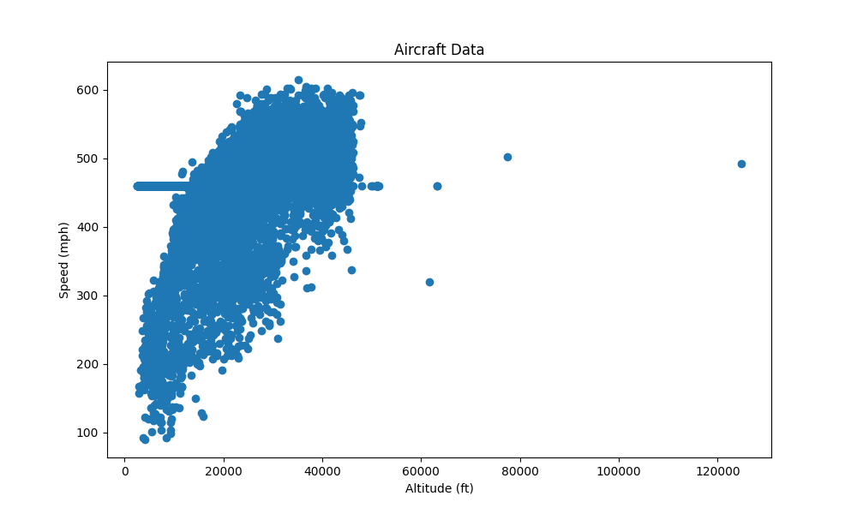
Data Before Cleaning
Issues:
Outliers
Linear Regression is sensitive to outliers
Odd line of data points near 460 miles per hour
Likely a missing value replacement (close to mean)
Omitting these values significantly improved model performance

Slide 4
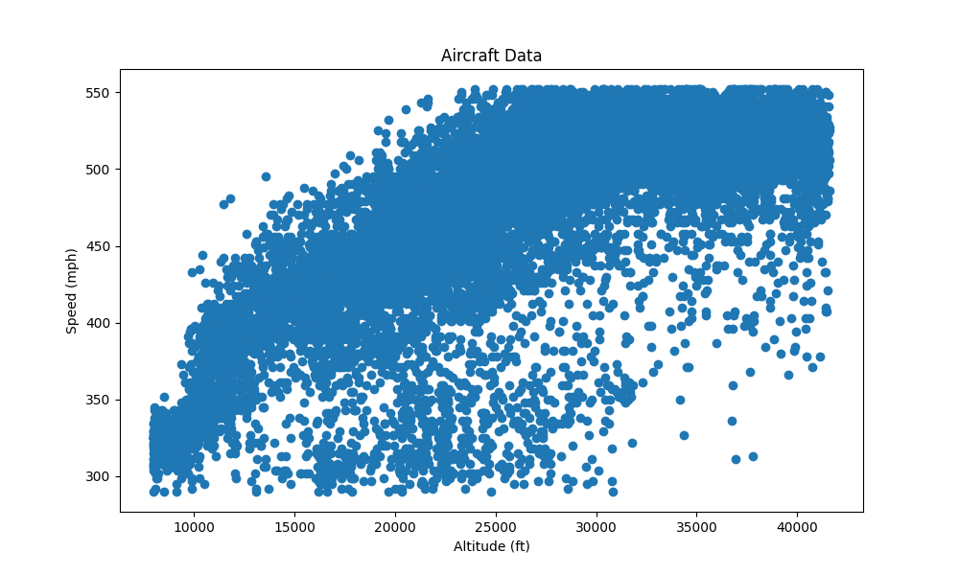
Processed Data
Observations:
A clear trend in the data
A curve can be fitted to this
Polynomial of degree 2 or 3 should be able to produce a decent best fit line

Slide 5
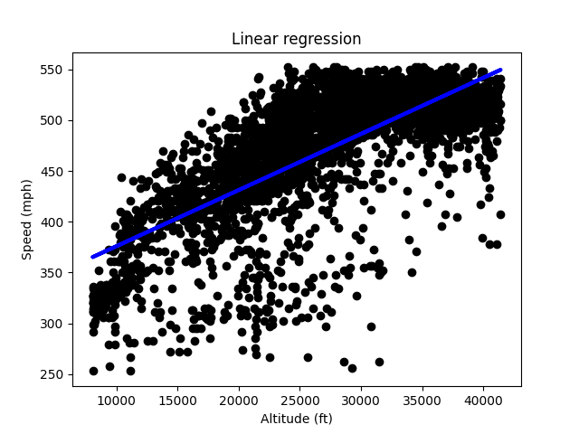
Linear Regression (Degree 1 Polynomial)
Metrics:
RMSE: 40.8
R2: 0.575

Slide 6
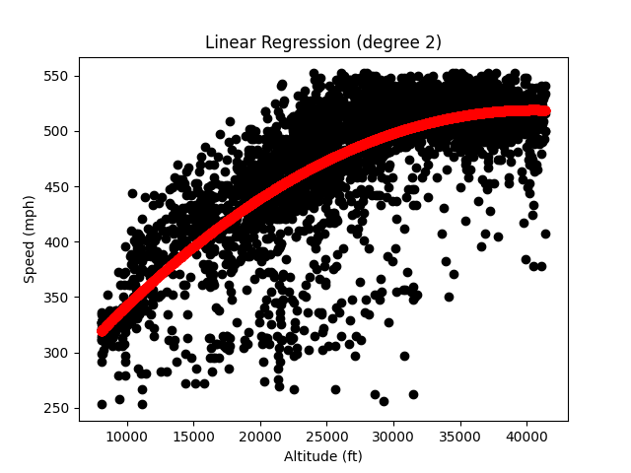
Linear Regression (Degree 2 Polynomial)
Metrics:
RMSE: 37.84
R2: 0.635

Slide 7
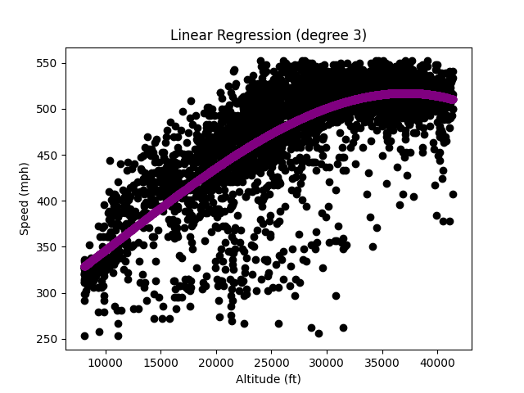
Linear Regression (Degree 3 Polynomial)
Metrics:
RMSE: 37.68
R2: 0.638

Slide 8
Failed Improvement Techniques
Scaling/Normalization:
Since there was only a single input feature, scaling
Regularization:
Neither L1 (Ridge) or L2 (Lasso) regularization improved the performance
Ensemble Models:
Gradient Boost and Random Forest models were tested,
But improvements were minimal
And were more likely to be overfitted to the dataset

Slide 9
Results
Data Cleaning
Removed outer 2% of data points
Both for mph and altitude
Removed all data points where mph = 460
While some of these would have been real data points
Many of them were likely replacing missing values
Model
Polynomial of degree 3
Github
https://github.com/jnshort/FlightDataML

